Slide 1
#Glasses for the blind
Intro
Hook
Explore
Stuctures
Code
Develop
Video for the project
/*Primer Team*/

Slide 2

What are # Glasses for the blind?
Intro
Hook
Explore
Stuctures
Code
Develop
Video for the project
Our project is glasses for the blind it will help them to walk in the street or anywhere without a need to help. It starts working by sensing a body at a distance 1 Metre away, then a sound will warn them to stop or take care about whichever coming.

Slide 3
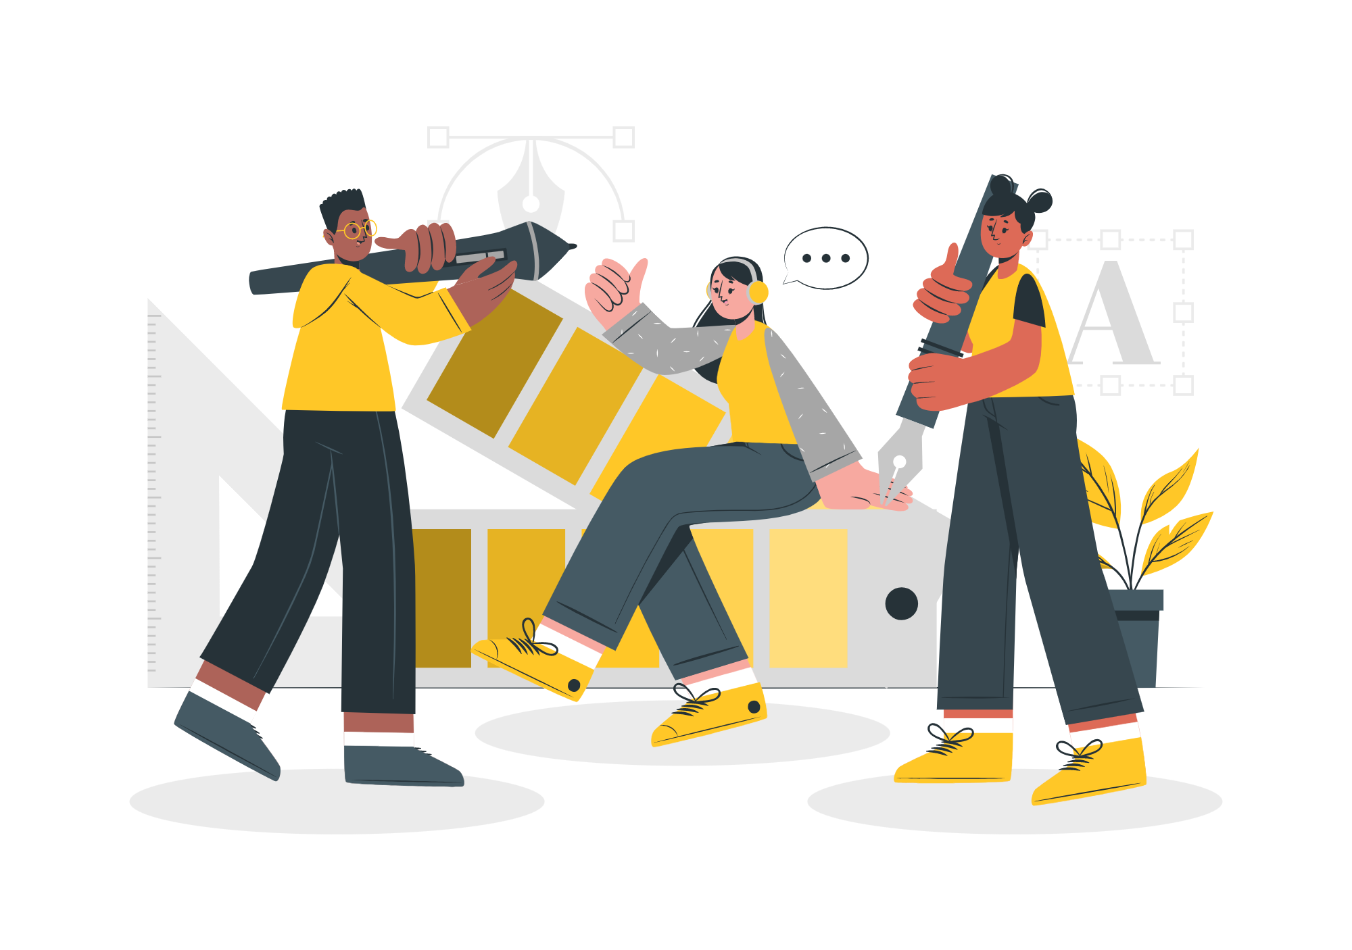
Before creating # Glasses for the blind
Intro
Hook
Explore
Stuctures
Code
Develop
Video for the project
Before glasses were created for the blind, they used sticks. But it was not practical because it does not make the person familiar with all the things around him. It may be broken or falling and the person cannot find it.

Slide 4
After creating # Glasses for the blind
Intro
Hook
Explore
Stuctures
Code
Develop
Video for the project
These glasses make the blind aware of obstacles they may crash . Before the innovation of these glasses the blind were waving a stick to determine if there is an obstacle or not, but the disadvantage of these sticks that they can lose it or the stick may annoy the other people around the blind

Slide 5
# Glasses for the blind
01
02
03
Hook
Explore
Structures
04
05
06
Code
Develop
Video For The Project
Intro
Hook
Explore
Stuctures
Code
Develop
Video for the project

Slide 6
Hook
Intro
Hook
Explore
Stuctures
Code
Develop
Video for the project
In this section we will pursue 2 objectives:
Object Detection: Sensor-based blind glasses are equipped with sensors that can detect objects in the wearer's surroundings. This feature helps the wearer to navigate through their environment safely and avoid obstacles.Get the student to think about the contents we are going to work on.

Slide 7
Hook
Intro
Hook
Explore
Stuctures
Code
Develop
Video for the project
In this section we will pursue 2 objectives:
2. Audio Feedback: These glasses also have an audio feedback system that provides the wearer with information about their surroundings. The audio feedback can be in the form of spoken words or sounds, which help the wearer to understand their environment better.

Slide 8
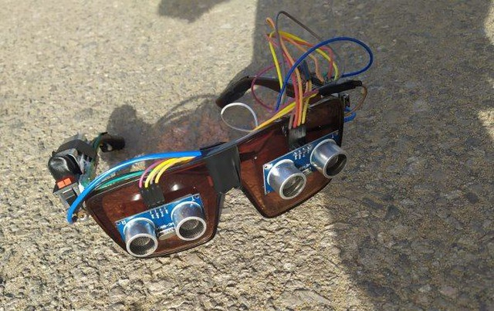
Explore
Intro
Hook
Explore
Stuctures
Code
Develop
Video for the project
In this section, inserting several links to various resources on the topic :
YouTube Video about glasses for the blind.
Another YouTube Video.
Project Hub on Arduino website.
Ultrasonic Glasses for the blind.
RESOURCES: Articles, videos, playlists, infographics, image collections, …

Slide 9
Explain
Intro
Hook
Explore
Stuctures
Code
Develop
Video for the project
We insert the contents to be worked on in the unit. In this part we can include:
Structures.
Code.
RESOURCES: Direct instruction, videos, playlists, presentations, infographics, images…
APPS: videos (Actual)

Slide 10
Explain
Intro
Hook
Explore
Stuctures
Code
Develop
Video for the project
we will talk about the structuring the project
consist of (ultrasonic sensors , 2 buzzers , nano Arduino, 9V battery, Switch, wires glasses), the /*Ultrasonic sensor is The most important part*/ :
Consists of 4 VCC pins connected
with 5v and GND connected
with GND in the Arduin and
2 pins (Trig/Echo),
trig for output,
echo for input.

Slide 11
How it works?
Intro
Hook
Explore
Stuctures
Code
Develop
Video for the project
The sensor makes waves from trig and calculate their collision time with anything in front of it and from that calculates the distance from this relation (v=d\t )and velocity is constant then divides the producted distance by 2 as (round_trip), And so give a warn according to the determined distance, THE BUZZER…
After that this the turn of the buzzer the sensor send
a signal to the buzzer when the distance is more
than 1 cm ,So the buzzer makes high signal
and makes a warning sound the connection
of buzzer<<< the positive pin with any another
pin and the negative pin with GND

Slide 12
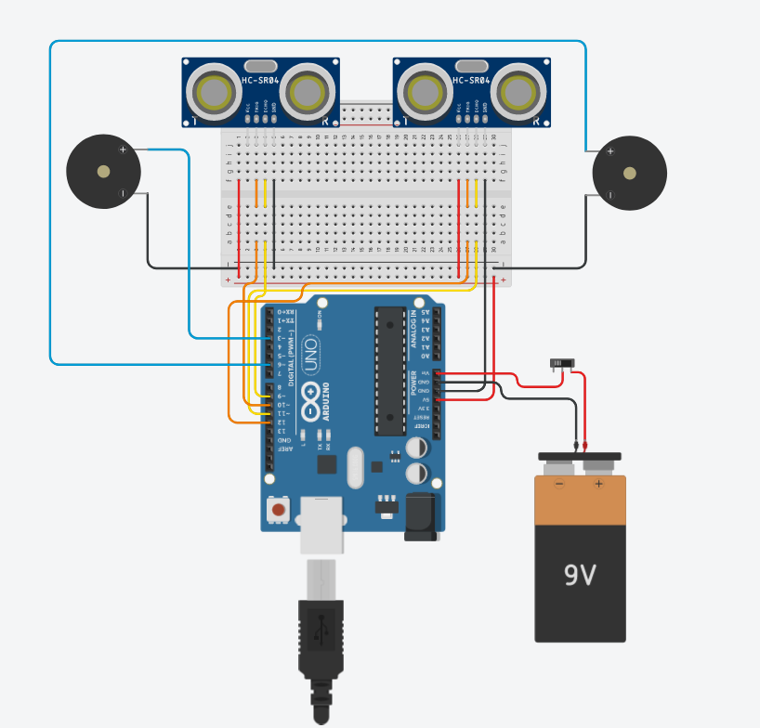
Simulation for Our Project
Intro
Hook
Explore
Stuctures
Code
Develop
Video for the project

Slide 13
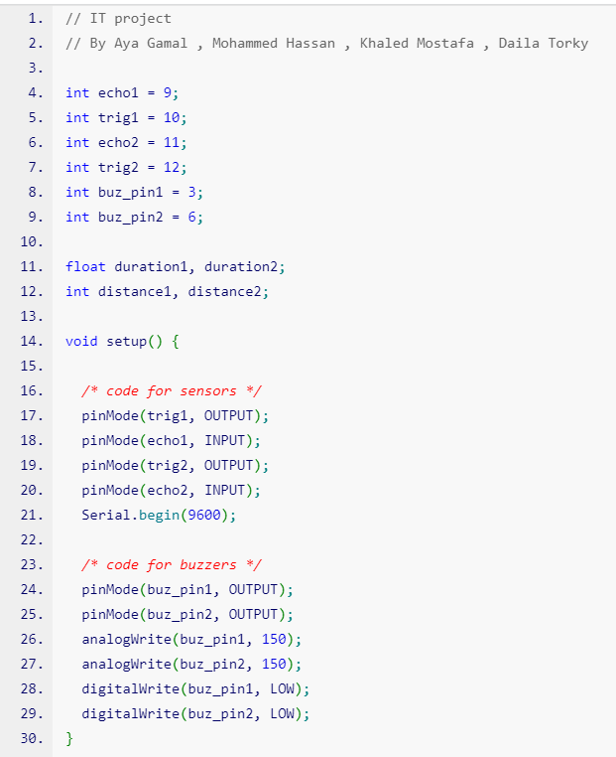
Code
Intro
Hook
Explore
Stuctures
Code
Develop
Video for the project
The code we developed controls two ultrasonic sensors and two buzzers.
The sensors detect distances and the buzzers produce sound based
on the distance measured. Here’s a breakdown of the code:
We define the pins used for each sensor and buzzer.
In the setup function, we set the pins as input/output,
initialize the serial communication, and set the initial states of the buzzers.
In the loop function, we trigger each sensor to send out an ultrasonic signal,
and measure the duration it takes for the signal to bounce back.
We use this duration to calculate the distance of
an object in front of each sensor.
Based on the distance measured, we produce sound from
the corresponding buzzer. We use the map function to convert the distance
value into a frequency and delay time that controls the sound produced. If the distance is over a certain threshold, we turn off the buzzer.

Slide 14
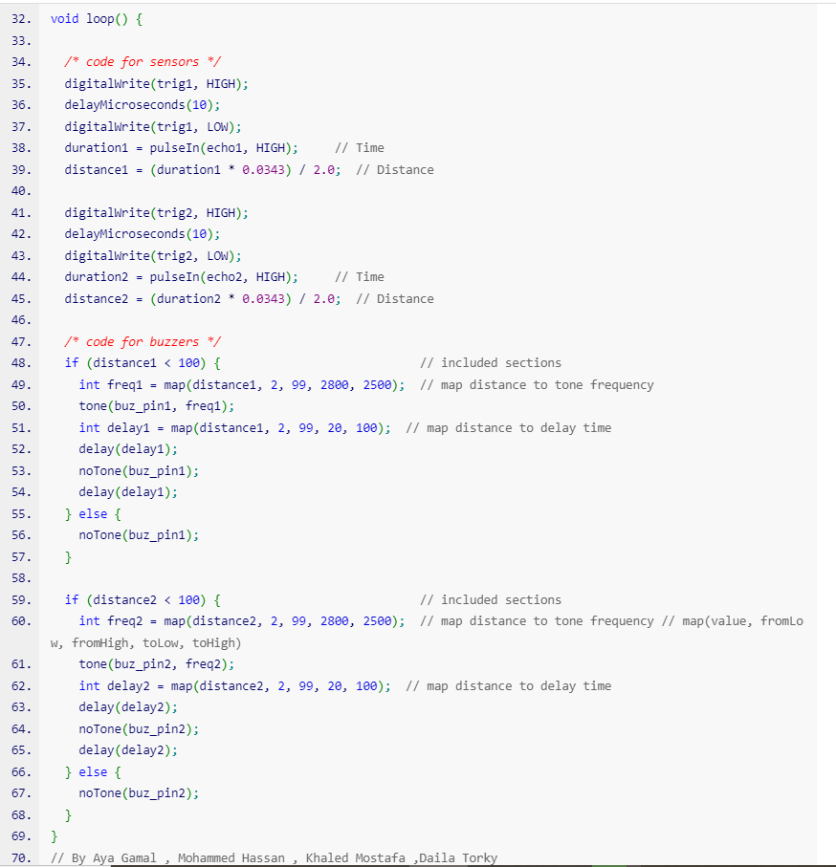
Code
Intro
Hook
Explore
Stuctures
Code
Develop
Video for the project
The code uses pulseIn() function to measure the duration of the echo signal produced by the ultrasonic sensor. The duration is then converted into distance by multiplying it with the speed of sound and dividing by two.
We use the tone() function to produce sound at a specific frequency and the delay() function to control the duration of the sound. We use the NoTone() function to turn off the sound.
The map() function is used to map a range of distance values to corresponding frequency and delay time values. This helps us produce sound that varies based on the distance measured.
The code can be modified to suit different applications, such as adding more sensors and buzzers or changing the thresholds for producing sound. With this code, we can create a system that alerts users to nearby objects or obstacles, and can be applied in various fields, such as robotics, automotive, and safety.

Slide 15
Adding features
Intro
Hook
Explore
Stuctures
Code
Develop
Video for the project
Even with these glasses, blind people are still at risk of come across unexpected obstacles , such as , low-obstacles branches or uneven pavemen. This could lead to accidents or injuries, and also made it difficult for them to move around .Therefore, we will study the subject to be more accurate than that by making a sensor on the foot or on the shoe.
We can Adding GPS like Apple smart Watch that can help them if an accident occurs, sending the person's location to the nearest hospital and to his family.

Slide 16

Intro
Hook
Explore
Stuctures
Code
Develop
Video for the project

Slide 17
Primer Team
Aya Gamal Al-Sayed Abdel Moniem
Basmala Medhat Almohamady Aboamna
Fatma Walid Mohamed Elsherif
Habiba Sameh Ibrahim Baly
Sarah Sherif Ali Abdelhamed
Shrouk Al-Sayed Al-Sayed Al-Bayoumi
Dalia Tarek Ahmed Torky
Farah Ahmed Mohamed Ali
Jessica Emad Fawzy Labib
Nadin Ehab Fawzy Badwy
Nada Ahmed Hussein Ali
Sohila Shawky Maher Shawky Mohamed Mashal
Khaled Mostafa Abdul-Rahim Al-Sayed
Mohamed Reda Mohamed Shosha
Mohamed Seyam Abo Elyazed Abo Kamla
Mohamed Hassan Eisa Abozied
Muhamed Hamed Muhamed Al-Sayed
Saif Walid Al-Dosouky Al-Shazly Al-Fiqi

Slide 18
#Thanks!
Do you have any questions?

